Slide 1
DIFFUSION EQUATIONS
EXPLICIT AND IMPLICIT
Dana Seibert- Vistas in Advanced Computing 2017

Slide 2
NUMERICAL Integration
What is numerical integration?
“Numerical integration is the approximate computation of an integral using numerical techniques” –Wolfram MathWorld
For our purposes, we can think of numerical integration as a way to perform multiple mathematical operations using similar equations in C programs.
Examples: Approximating derivatives, Tracking planetary motion, Visualizing Lorentz models, Establishing diffusivity trends

Slide 3

DIFFUSION EQUATION
One dimension general form:
$$\frac{\text{∂}u}{\text{∂}t}=D\frac{{\text{∂}}^{2}u}{\text{∂}x^{2}}+F(x,t)$$
Where $D$ is a constant parameter dependent on the specific problem
Diffusivity
For heat transfer, $D=k/ρc_{p}$ (thermal diffusivity)
$F$ is a known source of heat
$u$ is a temperature in excess
For diffusion of a fluid, it would be a concentration

Slide 4

DIFFUSION EQUATION
$$\frac{\text{∂}u}{\text{∂}t}=D\frac{{\text{∂}}^{2}u}{\text{∂}x^{2}}+F(x,t)$$
Needs an initial condition:
$u\left(x,t=0\right)=f(x)$
Needs boundary conditions at endpoints $x=0$ and $x=L$:
Dirichlet type:
$u\left(x=0,t\right)=g_{0}\left(t\right),$ $u\left(x=L,t\right)=g_{L}\left(t\right)$
Neumann type:
${\left.\frac{∂u}{∂t}\right|}_{x=0}=h_{0}\left(t\right),$ ${\left.\frac{∂u}{∂t}\right|}_{x=L}=h_{L}\left(t\right)$
One end Dirichlet type and one end Neumann type

Slide 5

EXPLICIT METHOD
Discretize $\frac{\text{∂}u}{\text{∂}t}=D\frac{{\text{∂}}^{2}u}{\text{∂}x^{2}}+F\left(x,t\right)$ into
$\frac{u_{j}^{n+1}−u_{j}^{n}}{∆t}=D\frac{u_{j−1}^{n}−2u_{j}^{n}+u_{j+1}^{n}}{∆x^{2}}+F(x_{j},t^{n})$
Where $u_{j}^{n}=u(j∆x,n∆t)$

Slide 6

EXPLICIT METHOD
$u_{j}^{n+1}$ is explicitly given, thus the name of the method
$u_{j}^{n+1}$ is explicitly given as:
$$u_{j}^{n+1}=u_{j}^{n}+λ\left(u_{j−1}^{n}−2u_{j}^{n}+u_{j+1}^{n}\right)+ΔtF(x_{j},t^{n})$$
where $λ=\frac{DΔt}{Δx^{2}}$

Slide 7
LAX EQUIVALENCE THEOREM
In general, a discretized method should approach the exact solution to a closer and closer degree
It should converge
Determine whether a method converges through Lax Equivalence Theorem
Lax equivalence theorem: Given a properly posed linear initial-value problem and a consistent finite-difference approximation to it, stability is the necessary and sufficient condition for convergence.

Slide 8

CONSISTENT DISCRETIZATION
Consistent discretization: difference between discretized formula and original formula tends to 0 as it becomes closer and closer
Test through application of Taylor series expansion of discretized formula:
$$\frac{∂u}{∂t}+\frac{∆t}{2}\frac{∂^{2}u}{∂t^{2}}+…=D\left(\frac{∂^{2}u}{∂x^{2}}+\frac{∆x^{2}}{12}\frac{∂^{4}u}{∂x^{4}}+…\right)$$
As $∆t$and $∆x$ are reduced, the original discretized formula is restored
Error of $O\left(∆t,∆x^{2}\right)$

Slide 9

STABILITY PROPERTIES
In order for the scheme to remain consistent, it cannot grow without bound
Stability prevents this
The scheme will only remain stable if
$$λ=\frac{DΔt}{Δx^{2}}<\frac{1}{2}$$
$L$ is the extent of spatial domain (time) we want to solve the problem
Time steps: usually an order of $L^{2}/D$, or $\frac{L^{2}}{\left(D∆t\right)}$
When using $λ=\frac{1}{2}$, need $≈{\left(L/∆x\right)}^{2}$ time steps
For accuracy with a small stable scheme, we want a small $∆x$
Thus, $λ<\frac{1}{2}$ is not a condition to use in practical applications
Notes:
Lambda<1/2, why we use implicit

Slide 10

FINAL DISCRETIZED FORMULA
If $u$ satisfies our original diffusion equation, $\frac{\text{∂}u}{\text{∂}t}=D\frac{{\text{∂}}^{2}u}{\text{∂}x^{2}}+F(x,t)$, and $F=0$,
$$\frac{∂^{2}u}{∂t^{2}}=\frac{∂}{∂t}\left(\frac{∂u}{∂t}\right)=\frac{∂}{∂t}\left(D\frac{∂^{2}u}{∂x^{2}}\right)=D\frac{∂^{2}}{∂x^{2}}\left(\frac{∂u}{∂t}\right)=D^{2}\frac{∂^{4}u}{∂x^{4}}$$
Now we can rewrite $\frac{∂u}{∂t}+\frac{∆t}{2}\frac{∂^{2}u}{∂t^{2}}+…=D\left(\frac{∂^{2}u}{∂x^{2}}+\frac{∆x^{2}}{12}\frac{∂^{4}u}{∂x^{4}}+…\right)$ as
$$\frac{∂u}{∂t}=D\frac{∂^{2}u}{∂x^{2}}+\frac{D^{2}{∆x}^{2}}{2}\left(\frac{1}{6}−λ\right)\frac{∂^{4}u}{∂x^{4}}$$
Shows $λ=\frac{1}{6}$ increases order of accuracy, but it is just a happy accident in this case

Slide 11

IMPLICIT METHOD
Another way to discretize $\frac{\text{∂}u}{\text{∂}t}=D\frac{{\text{∂}}^{2}u}{\text{∂}x^{2}}+F(x,t)$ is through implicit discretization
$$\frac{u_{j}^{n+1}−u_{j}^{n}}{∆t}=D\frac{u_{j−1}^{n+1}−2u_{j}^{n+1}+u_{j+1}^{n+1}}{∆x^{2}}+F\left(x_{j},t^{n+1}\right)$$
In this case, $u_{j}^{n+1}$ cannot be separated from the values of $u$ at other points
In order to solve for $u_{j}^{n+1}$, we must use the tri-diagonal method and solve:
$−λu_{j−1}^{n+1}+\left(1+λ\right)u_{j}^{n+1}−λu_{j+1}^{n+1}=u_{j}^{n}+ΔtF\left(x_{j},t^{n+1}\right)$, $λ=\frac{DΔt}{Δx^{2}}$

Slide 12

IMPLICIT METHOD
$−λu_{j−1}^{n+1}+\left(1+2λ\right)u_{j}^{n+1}−λu_{j+1}^{n+1}=u_{j}^{n}+ΔtF\left(x_{j},t^{n+1}\right)$, $λ=\frac{DΔt}{Δx^{2}}$
If $F=0$,
$$\frac{∂u}{∂t}=D\frac{∂^{2}u}{∂x^{2}}+\frac{D^{2}{∆x}^{2}}{2}\left(\frac{1}{6}+λ\right)\frac{∂^{4}u}{∂x^{4}}$$
No special value of $λ$ will increase order of accuracy
Implicit Method is unconditionally stable, but cannot use large time steps because the discretization is only first-order accurate in $Δt$
Results from strong damping of short-scale features that are not relevant to solution

Slide 13
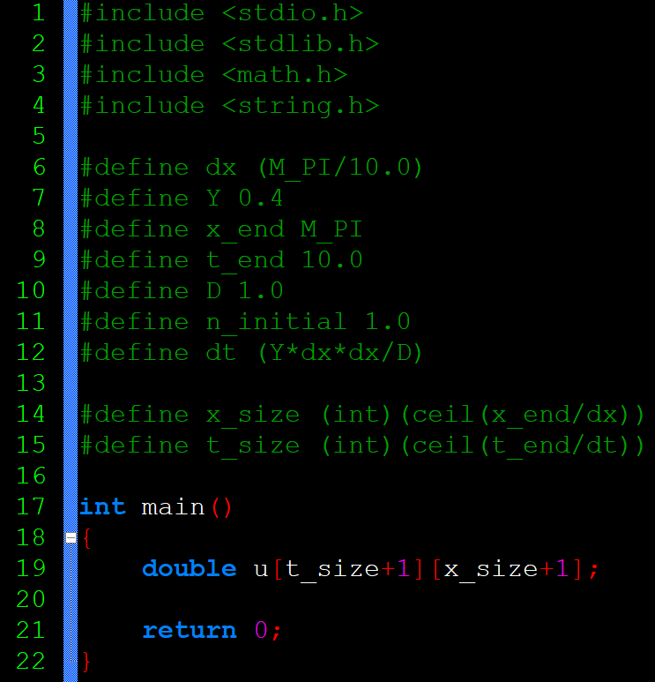

CODE - EXPLICIT
10.6.1.1
$$\frac{\text{∂}u}{\text{∂}t}=D\frac{{\text{∂}}^{2}u}{\text{∂}x^{2}}+F(x,t)$$

Slide 14
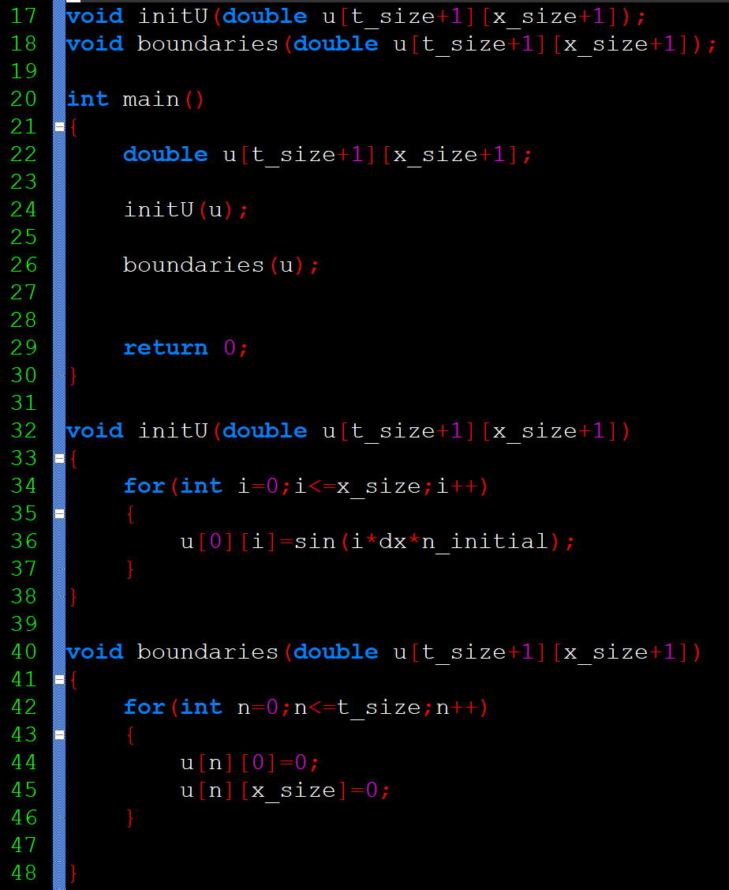
CODE - EXPLICIT
Establishes all values in 1st row
Sets all values in 1st and last column to 0

Slide 15
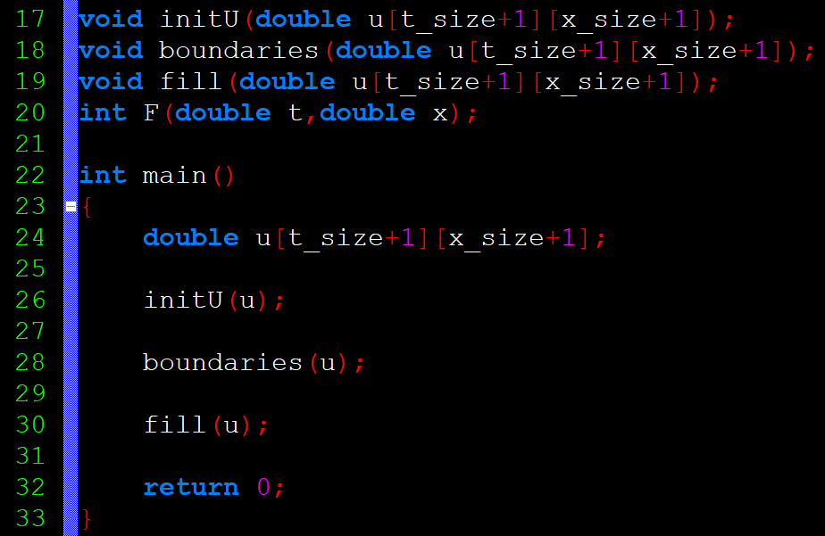
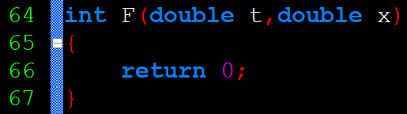
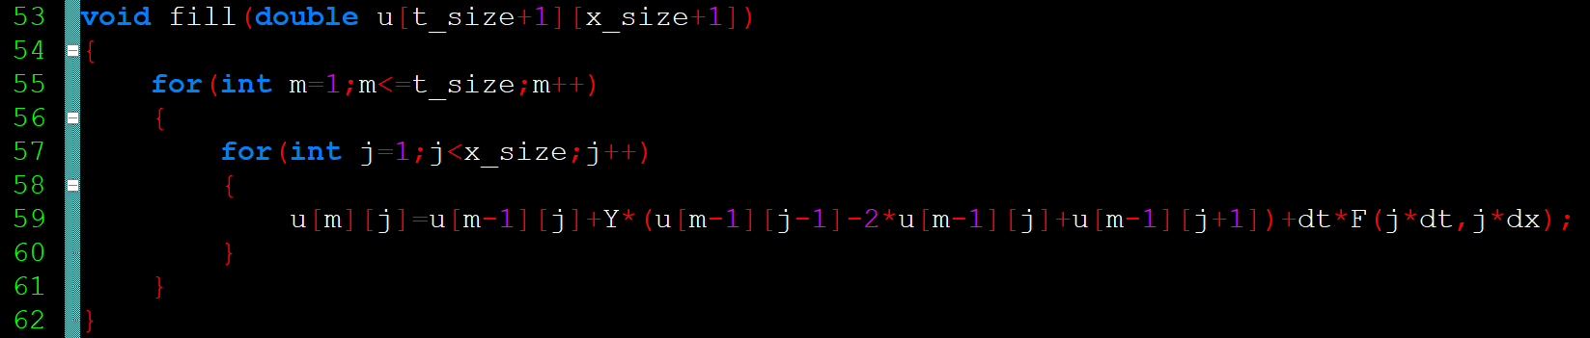

CODE - EXPLICIT
$u_{j}^{n+1}=u_{j}^{n}+λ\left(u_{j−1}^{n}−2u_{j}^{n}+u_{j+1}^{n}\right)+ΔtF(x_{j},t^{n})$, $λ=\frac{DΔt}{Δx^{2}}$
-1
-1
-1
-1
-1

Slide 16
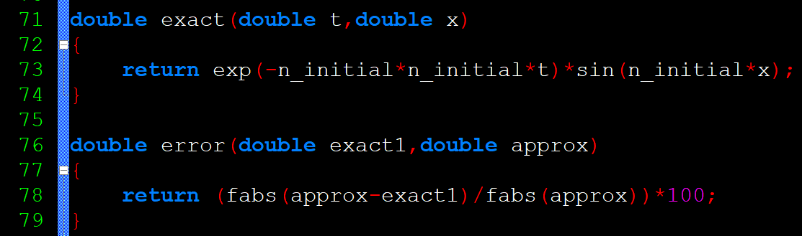

CODE - EXPLICIT
Finding Exact and Error
$$u_{exact}=exp⁡\left(−n^{2}t\right)\sin\left(nx\right)$$

Slide 17
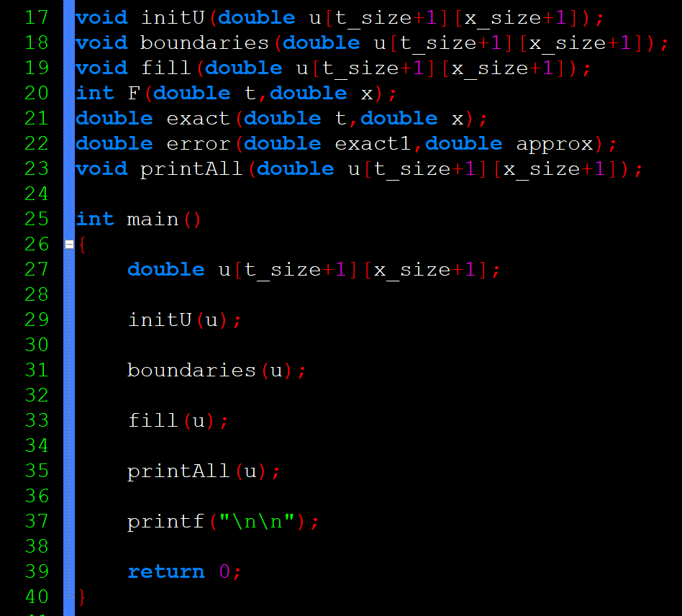
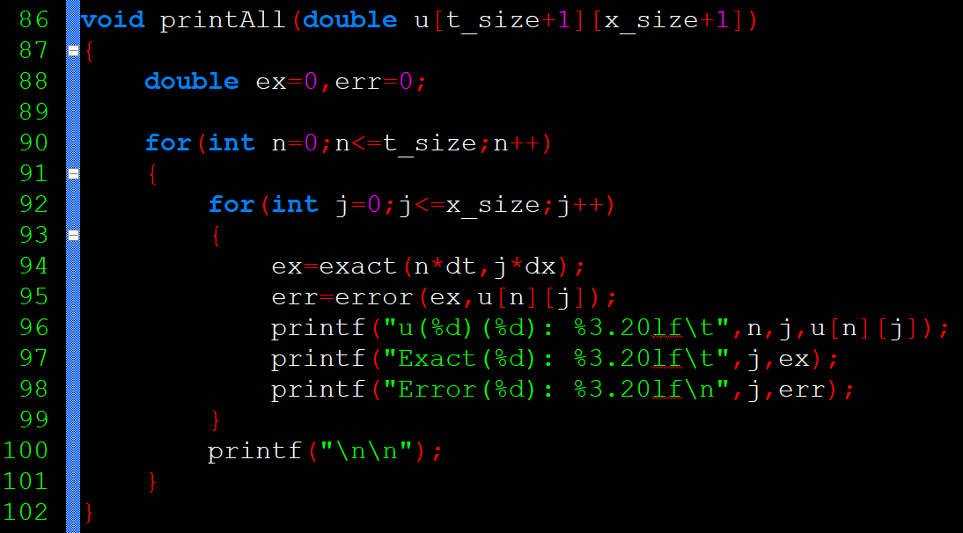
CODE - EXPLICIT

Slide 18
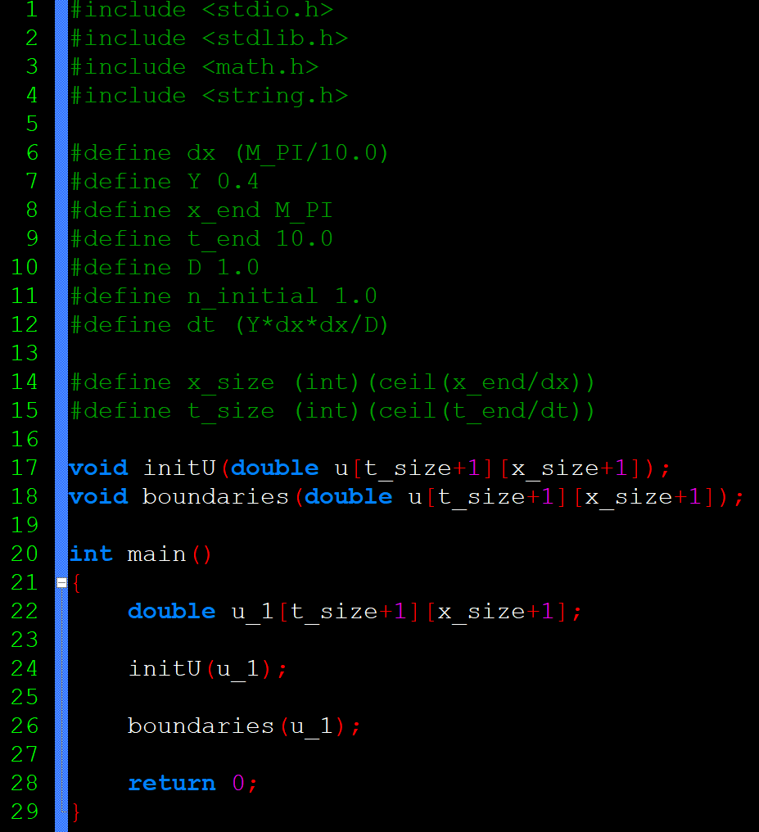
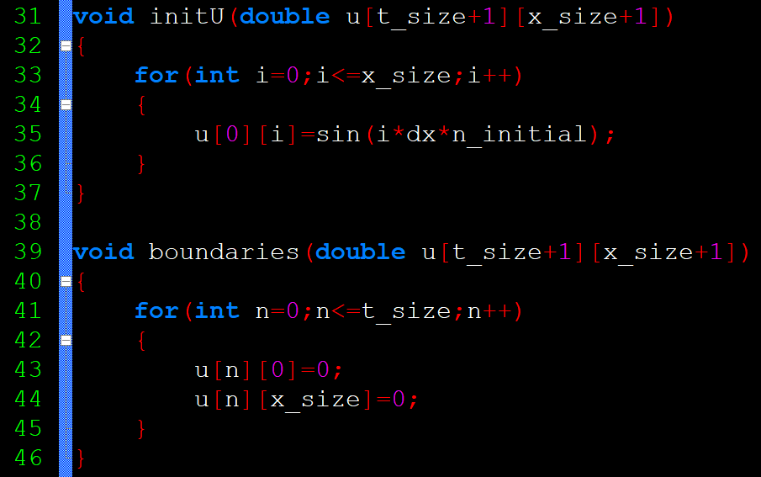

CODE - IMPLICIT
10.6.1.2
$$\frac{\text{∂}u}{\text{∂}t}=D\frac{{\text{∂}}^{2}u}{\text{∂}x^{2}}+F(x,t)$$

Slide 19
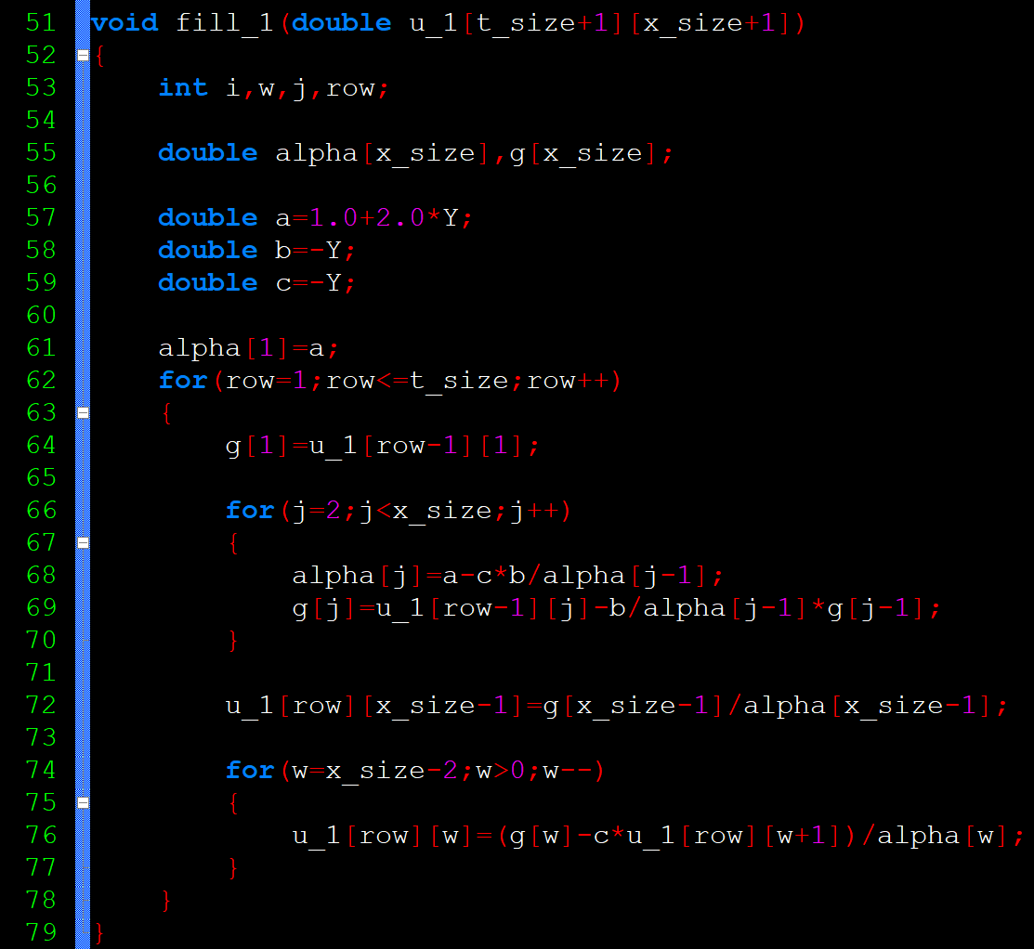
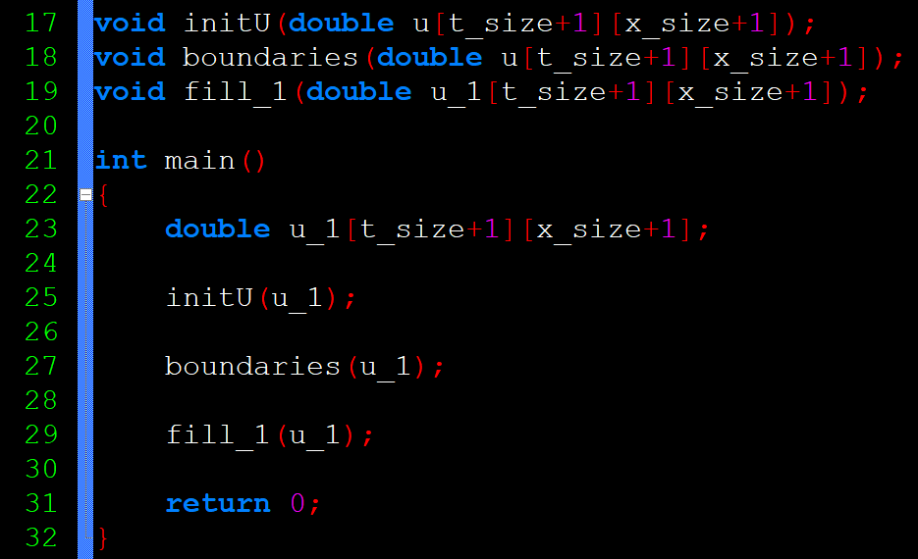

CODE - IMPLICIT
= 0
$−λu_{j−1}^{n+1}+\left(1+2λ\right)u_{j}^{n+1}−λu_{j+1}^{n+1}=u_{j}^{n}+ΔtF\left(x_{j},t^{n+1}\right)$, $λ=\frac{DΔt}{Δx^{2}}$
Tri-diagonal Method

Slide 20
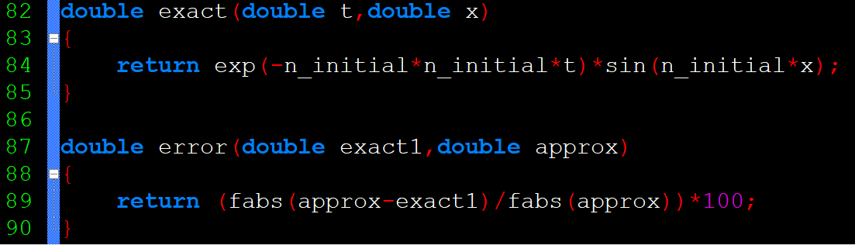
CODE - IMPLICIT
Same Exact and Error Equations as Explicit

Slide 21
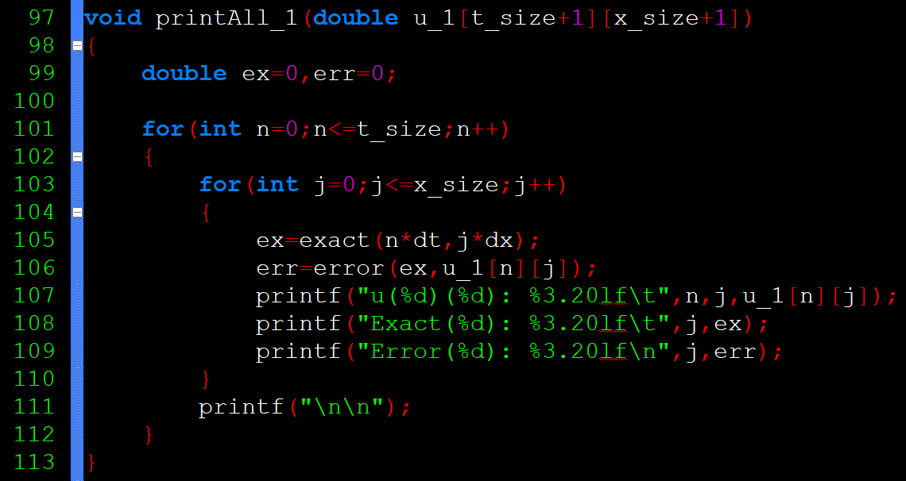
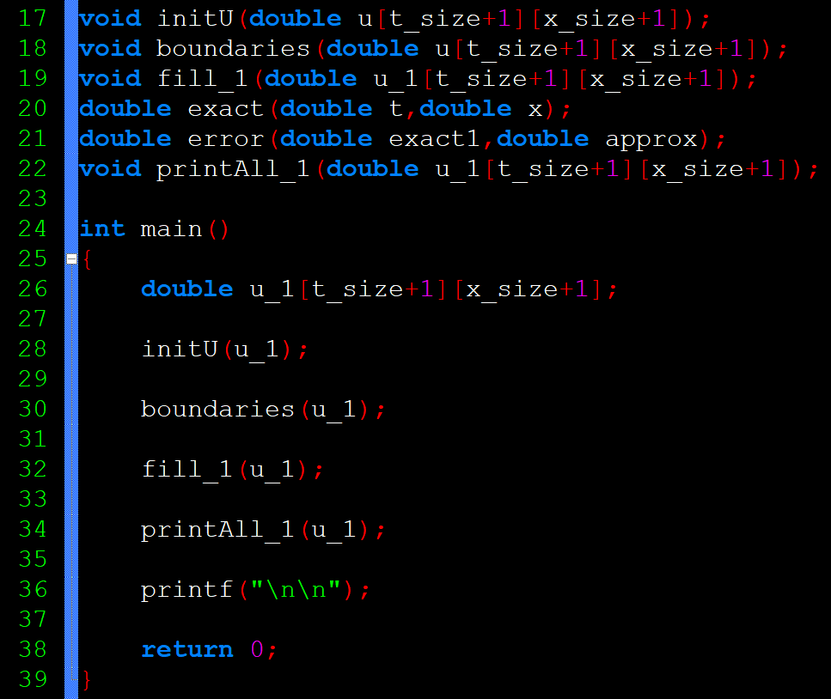
CODE - IMPLICIT

